Slide 1
Investment Efficiency Resource Exit/Entry in Organized Electricity Markets
Vincent P. Duane
SVP Law, Compliance & External Relations
PJM Interconnection, LLC

Slide 2
Key Question
Can we rely on PJM’s organized wholesale electricity market to efficiently and reliably manage the entry and exit of supply resources as external forces create tremendous uncertainty and potential industry transformation?

Slide 3
Comparison of New Natural Gas Generation
 | PJM |  | Virginia |  |  | Florida
 | PJM Capacity, Energy and AS Revenues (based on net energy revenues) |  | Brunswick County | Bear Garden County | Warren County | Cape Canaveral | Riviera | Port Everglades
 | RTO | EMAAC
Annual Revenue ($/MW-yr) | 124,029 | 151,418 | 118,810 | 120,696 | 97,330 | 137,750 | 187,200 | 169,146

Slide 4
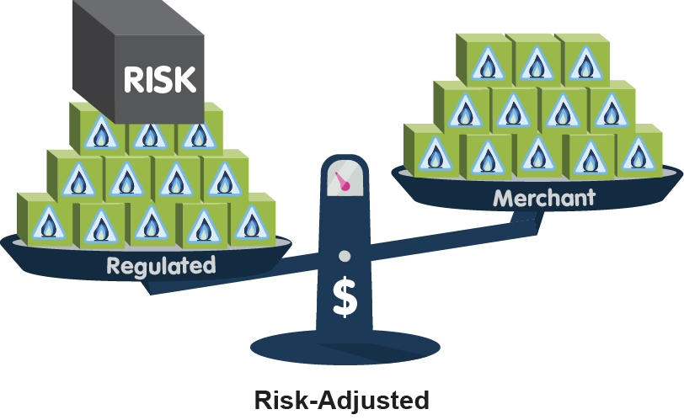
New Investments – Risk Adjusted Costs

Slide 5
Exit
This is the claim. . .
“[P]oorly structured electricity markets are putting at risk other well-operated, proven nuclear-energy facilities in New York, Ohio, Illinois and other states. Once closed, these plants won’t reopen. We must act now before it is too late.”
Christine Todd-Whitman, WSJ (2015)
First Energy is seeking a power purchase agreement to “prevent plants from retiring before it is economic to do so.”
Deposition Testimony, Larry Makovich, Public Utilities Commission Ohio (2015)

Slide 6
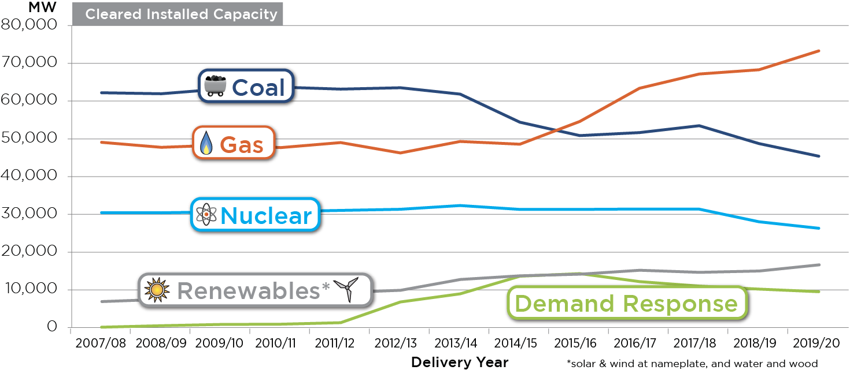
Cleared Installed Capacity
Notes:
Bastian/Helm RPM results
5/25/2016

Slide 7
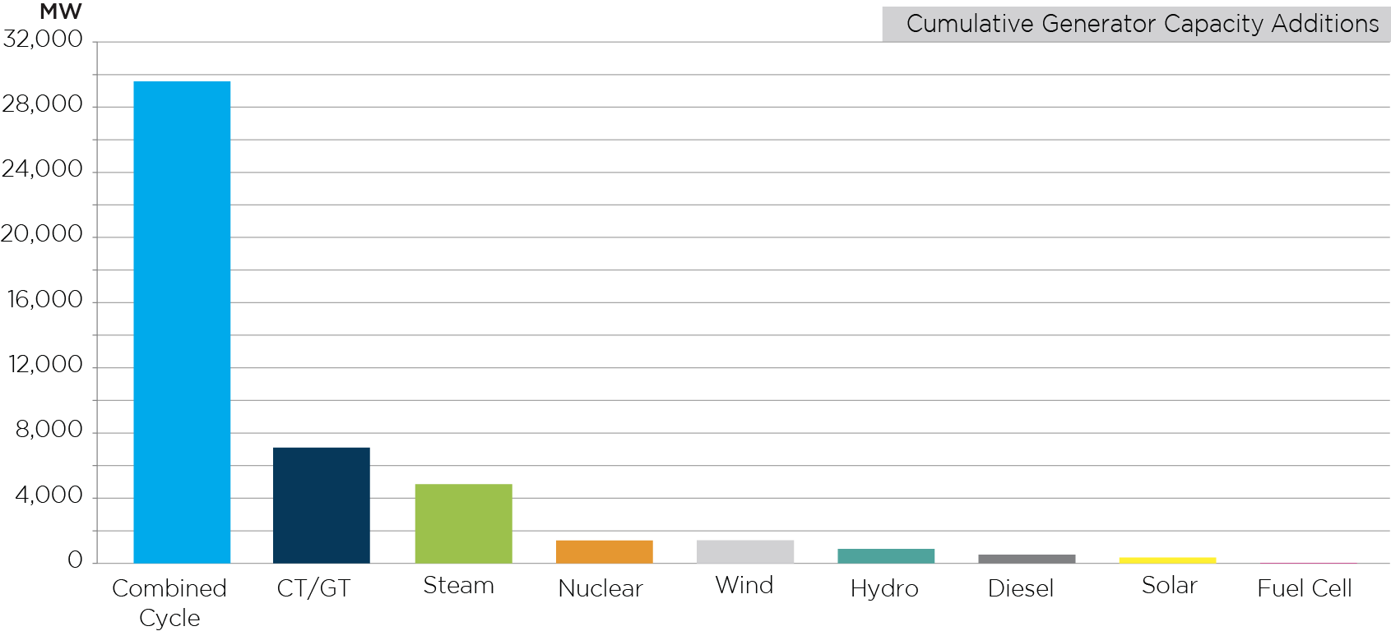
Cumulative Generator Capacity Additions Since 2007/ 08
80% Gas
Total=36,000 MW
Notes:
Updated 2018 with 2019/2020 BRA results Jeff bastion

Slide 8
Concern With Markets Managing Retirements
Price – short sighted; gas prices will rise
Price/Reliability - delivery concerns
Reliability - Operational attributes (baseload v. flexibility)
Reliability - Long term adequacy; black swan events; “perish the fleet”
Environmental Policy – zero emission
Social/Political Policies
Jobs, economic vitality, etc.
“Efficient” vs. “best” portfolio
Conclusion: (i) markets can implement well-designed enviro policies, and/or (ii) markets can be changed to permit subsidized projects while protecting market price integrity.
Notes:
Illustrated graphically with out-of-market PPA example

